Slide 1
HAYSTACK
Niharika Morishetti

Slide 2
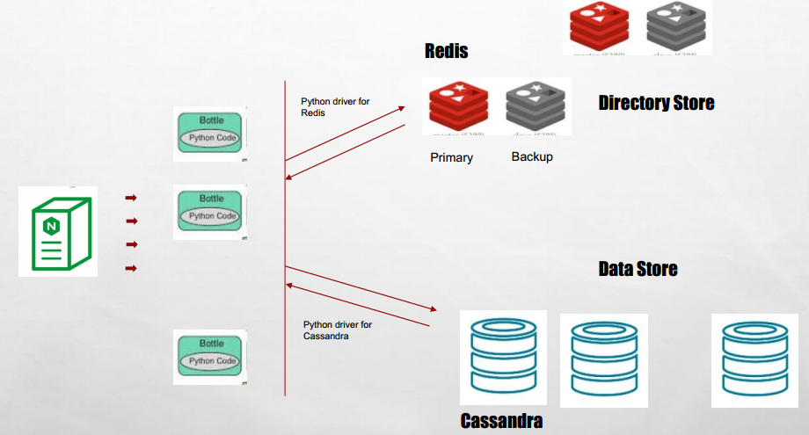
DESIGN

Slide 3
DESIGN TRADEOFFS
Directory Store: I choose to use the Redis as our directory store as it is very fast and it has a persistent storage. And we can have a backup for the primary which would be make a failure prone system along with that we can extend the Redis design by hosting many redis storages on different node which would be more robust.
Data Store:
We choose to use the Cassandra as our data store and using the in memory cache option in Cassandra made us to use only Cassandra without Redis. We host the cluster of Cassandra machines which made us robust with data store design.

Slide 4
IN MEMORY CACHE - CASSANDRA
I opted to choose the In-Memory Cache in Cassandra instead of Redis for few reasons:
1. We reduce a hop in the network because a miss in Redis cache would result in another request to Cassandra nodes.
2. Easy deployment and management: HayStack was designed to be simple. So, using in-memory cache inside Cassandra gives the good performance from using memory as well as provides way to deploy easily. This also reduces a point of failure in the system by not using another node.

Slide 5
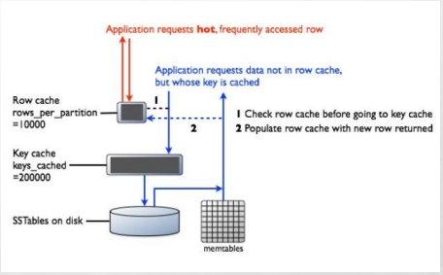
In memory cache design

Slide 6
SCALABILITY
There are total three points where we can scale the system:
NGINX: We can use the nginx load balancer which can give us option of running multiple bottle servers backend.
REDIS: We can host multiple redis servers as primary and backup and we can scale the whole dual setup.
CASSANDRA: We can host multiple Cassandra data stores which gives our system to be more resilient.

Slide 7
Installations required:
Redis
Cassandra
Virtual env
NGINX

Slide 8
Instructions to run the code
'bash -s' < shell_script_for_cassandra.sh 'bash -s' < shell_script_for_nginx.sh 'bash -s' < shell_script_for_redis.sh 'bash -s' < shell_script_for_bottle.sh

Slide 9
Code Descriptions
1. Download ngnix, redis, cassandra.
2. Untar and start respective programs in the machines.
3. For bottle server we used virtual environment to start the server for more usability.
4. one html page to up load the files.
5. bottle servers contains the connection to nginx and cassendra details for storing.

